Slide 1
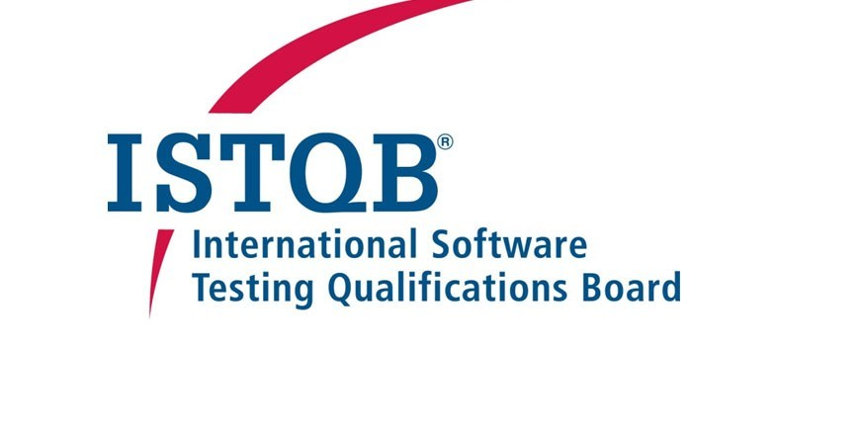
ISTQB Foundation Level – Syllabus V 4.0 2023
Mohammed Sallam

Slide 2
CTFL-ISTQB Outline
Ch1-Fundamentals of Testing (8Q).
Ch2-Testing Throughout the Software Life Cycle (5Q).
Ch3-Static Techniques (5Q).
Ch4-Test Design Techniques (11Q).
Ch5-Test Management (9Q).
Ch6-Tools Support For Testing (2Q).

Slide 3
Ch1. Fundamentals of Testing
What is The Testing?
Why is Testing Necessary?
Seven Testing Principles
Fundamental Test Process
The Psychology of Testing

Slide 4
What is Testing?
Software testing is a process of executing a program to find software bugs in different level of SDLC (Requirement , Analysis , Design .. Etc.).
Make sure everything's work as expected !
To meets the business (Functional) and technical (Non Functional) requirements.
Software that does not work correctly can lead to many problems, including:
1.loss of money, time, or business reputation
2. Injury or death (Embedded system).

Slide 5
What is Testing?
Software Testing ≠ Test Execution
Software testing is a process which includes many different activities
Execution is only one of these activities.

Slide 6
What is Testing?
Let’s break down the basic definition of Software testing into the following parts:
Static Testing: find defects without executing code. For example: reviewing documents , walkthrough, inspection, etc.
Dynamic Testing: The software code is executed to Show the result of running tests.

Slide 7
Why is Testing Necessary?
Reduces the risk of problems occurring when users use the software finding software defects during software development to fix it before released.
Ensure the quality of the product
Makes sure that the customer satisfied

Slide 8
Verification and Validation
Verification : Are we building the system right ? We following process and guideline.
Validation : Are we building the right system? As the client expected !

Slide 9
Testing Objectives
Need for Testing | Objective(s)
Requirements Review | Preventing defects
Development Testing | Finding defects Reducing Risk
Operational Testing -non-functional | Check system characteristics such as: Usability , availability , and security.
Acceptance Testing | Confirm the software works as expected. Providing Information to Stakeholders
Maintenance Testing | No new defects have been introduced during fixing the changes.

Slide 10
Test Objectives (2)
Evaluating work products such as requirements, user stories, designs, and code
• Triggering failures and finding defects
• Ensuring required coverage of a test object
• Reducing the level of risk of software quality
• Verifying whether specified requirements have been fulfilled
• Verifying that a test object complies with contractual, legal, and regulatory requirements
• Providing information to stakeholders to allow them to make informed decisions
• Building confidence in the quality of the test object
• Validating whether the test object is complete and works as expected by the stakeholders

Slide 11
Testing and Debugging
Testing : Executing tests (test case) to show failures. Done by TESTER
Debugging: is the development activity that finds, analyzes, and fixes issue. Done by DEVEOPER. NOTE: In Agile development and in some other lifecycles, testers may
be involved in debugging and component testing.

Slide 12
How much Testing is enough?
Prioritize tests so that, whenever you stop testing, you have done the best testing in the time available.
What is the test suite that high priority ?

Slide 13
Quality Management
Includes all activities that direct and control an organization with regard to quality (QA and QC)

Slide 14
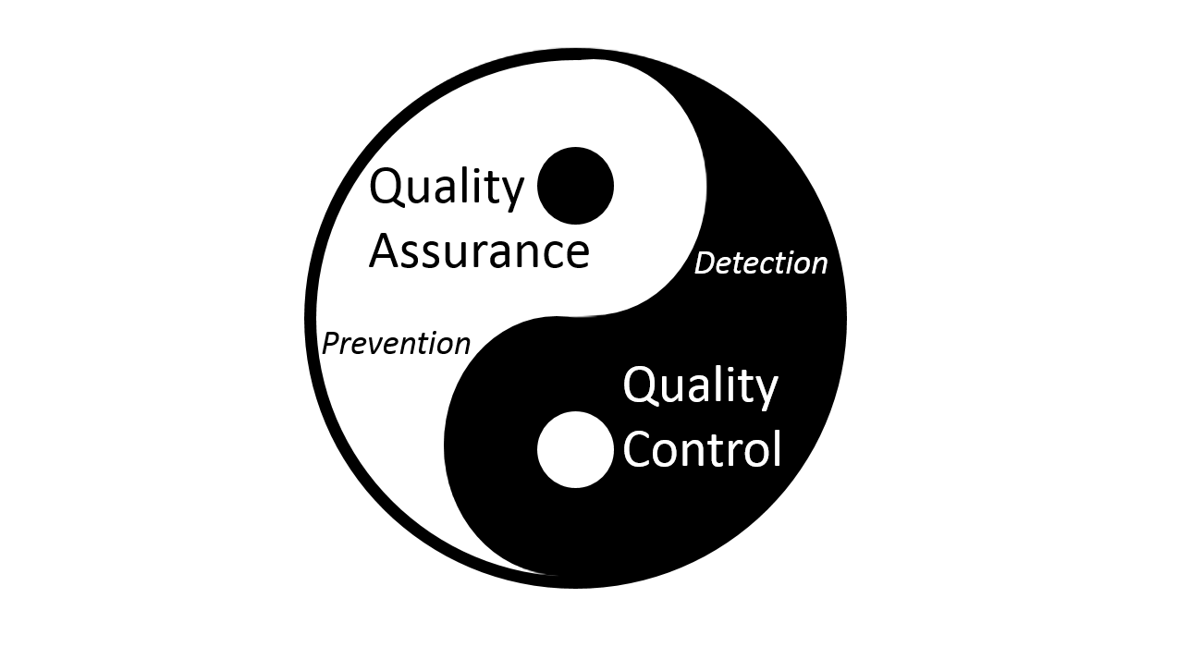
QA vs. QC?
Quality assurance focused on processes (Prevention Defect)
Quality control [Testing] focused on product Quality (Detection Defect)

Slide 15
Errors, Defects, and Failures
Error : human action, logic Error in code for example missing continue on while loop in JAVA. Defect (bug): Any deviation of functional specification document ,When Actual result different of the expected result. For example as a user I want to login by email (Expected Result) But Actually system implemented to login by phone number . Failures:Part of the system crashed.

Slide 16
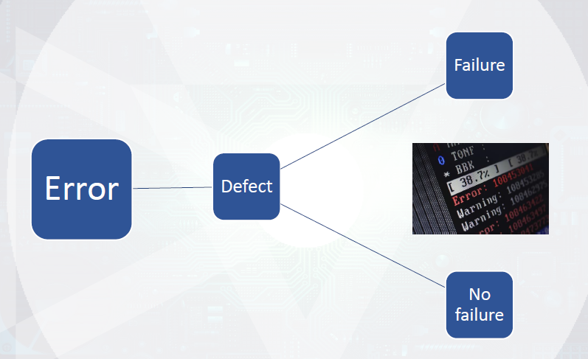

Slide 17
Why do errors happen ?
Time pressure
Lack of Experience
Miscommunication
Complexity of work products
System Interactions
New technologies

Slide 18
False Positive Vs. False Negative
False Positive [Invalid bugs] :
When a test case fails, but in actuality there is no bug and the functionality is working correctly.
When execute test case using wrong test data will introduce defect.
False Negative :
Software already containing failure but not appears during testing.

Slide 19
False positive or false negative ?

Slide 20
Root Cause Analysis
The root causes of defects are the earliest actions or conditions that contributed to creating the defects.

Slide 21


Slide 22
Which of the following statements is a valid objective for testing?
A. To determine whether enough component tests were executed within system testing
B. To find as many failures as possible so that defects can be identified and corrected
C. To prove that all possible defects are identified
D. To prove that any remaining defects will not cause any failures

Slide 23
Which of the following statements correctly describes the difference between testing and debugging?
A. Testing identifies the source of defects; debugging analyzes the defects and proposes prevention activities
B. Testing shows failures caused by defects; debugging finds, analyzes, and removes the causes of failures in the software
C. Testing removes faults; debugging identifies the causes of failures
D. Testing prevents the causes of failures; debugging removes the failures

Slide 24
When the tester verifies the test basis while designing tests early in the lifecycle, which common test objective is being achieved?
A. Gaining Confidence
B. Finding Defects
C. Preventing Defects
D. Providing information for decision making

Slide 25
Which of the following is an example of debugging?
A. A tester finds a defect and reports it
B. A tester retests a fix from the developer and finds a regression
C. A developer finds and fixes a defect
D. A developer performs unit testing

Slide 26
Which of the following is the activity that removes the cause of a failure?
A. Testing
B. Dynamic Testing
C. Debugging
D. Reverse Engineering

Slide 27
What type of activity is normally used to find and fix a defect in the code?
A. Regression Testing
B. Debugging
C. Dynamic analysis
D. Static analysis

Slide 28
Which one of the statements below describes a failure discovered during testing or in production?
A. The product crashed when the user selected an option in a dialog box
B. The wrong version of one source code file was included in the build
C. The computation algorithm used the wrong input variables
D. The developer misinterpreted the requirement for the algorithm

Slide 29
Which of the following is a correct statement?
A.A developer makes a mistake which causes a defect that may be seen as a failure during dynamic testing
B.A developer makes an error which results in a failure that may be seen as a fault when the software is executed
C.A developer has introduced a failure which results in a defect that may be seen as a mistake during dynamic testing
D.A developer makes a mistake which causes a bug that may be seen as a defect when the software is executed

Slide 30
In what way does root cause analysis contribute to process improvement?
A. Helps to better identify and correct the root cause of defects
B. Outlines how development teams can code faster
C. Specifies the desired root causes to be achieved by other teams
D. Contributes to the justification of future project funding

Slide 31
Which of the following is the correct statement?
A. An error causes a failure which results in a defect
B.A defect causes a failure which results in an error
C.A failure is observed as an error and the root cause is the defect
D. An error causes a defect which is observed as a failure

Slide 32
Bug Report Contents
Field | Description
Summary | A brief one-line summary of the bug
Descriptions | The more detailed included test step, actual result and expected result to reproduce this bug
Report ID | A unique identifier for this bug
Project name | The parent project to which the bug belongs.
Priority | how quickly the bug should be fixed and deployed e.g., Low, Medium, and High
Environment | this issue occurred on any environment e.g. Production, pre-production, staging, and development.
Attachment | Any screenshots, documents, voice notes, or video recordings that can assist in identifying and fixing the bug
Assignee | A person who is responsible to fix the bug. e.g. developer, Designer.
Reporter | A person who created bugs e.g. QA
created date | Bug submitted date.
Status | The stage the bug is currently at in its lifecycle (workflow).
Fix version | Project version(s) in which the bugs will be fixed.
Component | Bug component(s) to which this bug relates. e.g. Android, IOS, Backend (DB).

Slide 33
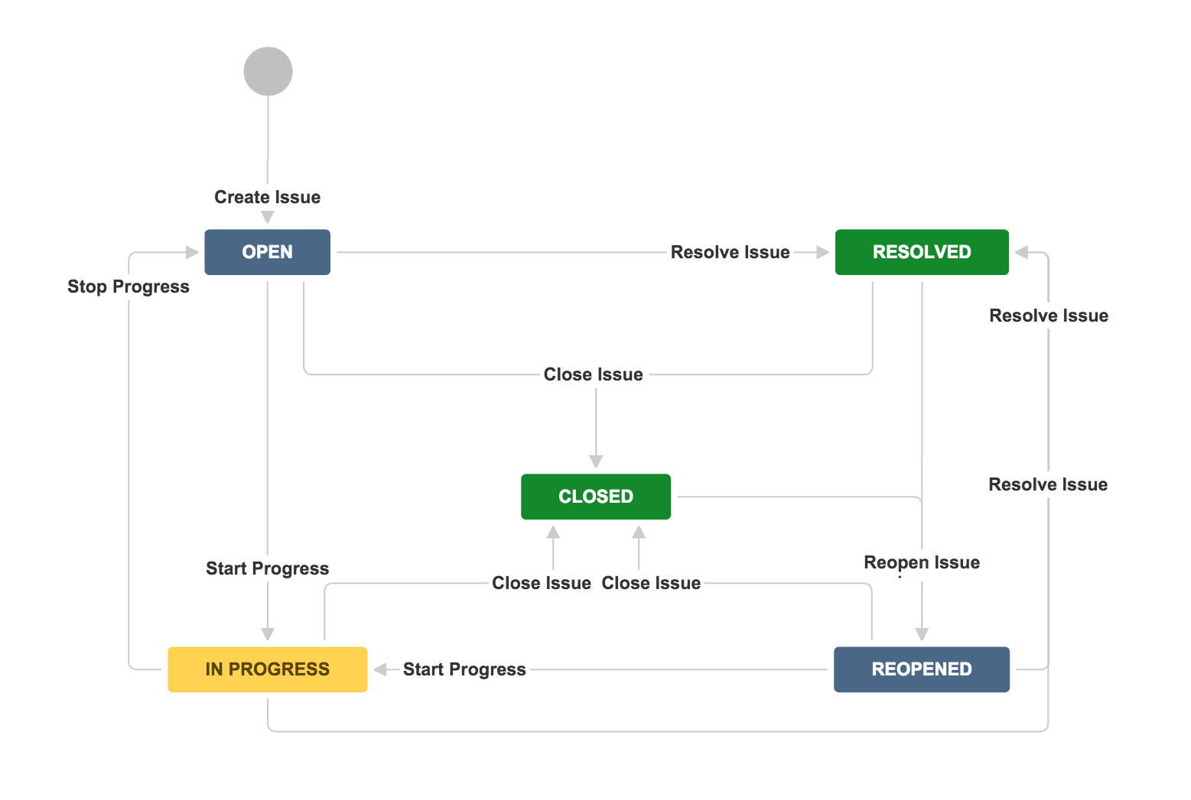
Bug Report lifecycle

Slide 34
Seven Testing Principles
Testing Shows Presence of Defects
Exhaustive Testing is impossible
Early Testing
Defect Clustering
Pesticide Paradox - Tests wear out
Testing is Context Dependent
Absence-of-Errors Fallacy

Slide 35
1) Testing Shows Presence of Defects
Testing … Prove that DEFECTS exist but cannot prove No DEFECTS exist.
We cannot say that the product is 100% free defect.
Testing always reduces the number of undiscovered defect.

Slide 36
2) Exhaustive Testing is impossible
Testing everything including all combinations of inputs is not possible.
We can use priorities to focus testing efforts.
It is not feasible except in the case of trivial software

Slide 37
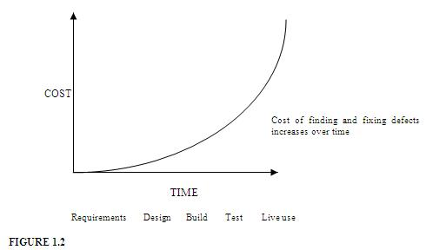
3) Early Testing

Slide 38
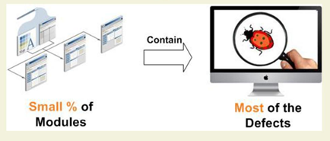
4) Defect Clustering
A small number of modules contains most of the defects discovered.

Slide 39
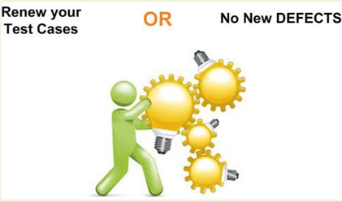
5) Pesticide Paradox - Tests wear out
If the same kinds of tests are repeated again and again with no longer be able to find any new bugs.
Should review the test cases regularly , and add new test case.

Slide 40
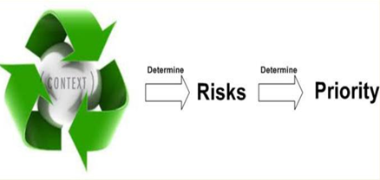
6) Testing is Context Dependent
Testing is basically context dependent Based on system , type of testing for e-commerce website is different of bank website.

Slide 41
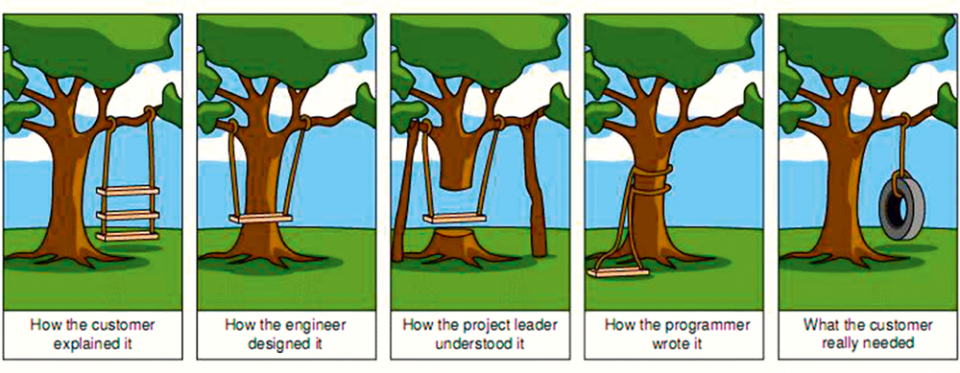
7) Absence-of-Errors Fallacy
If the system built is unusable and does not fulfil the user’s needs and expectations then finding and fixing defects does not help.
Fulfill User needs … Then … Find Defects.

Slide 42
Test Process
There is no one universal software test process, but there are common sets of test activities.

Slide 43
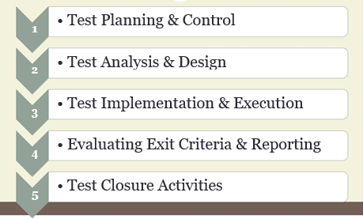
Test Activities

Slide 44
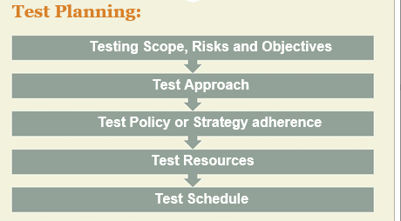
Test Planning

Slide 45
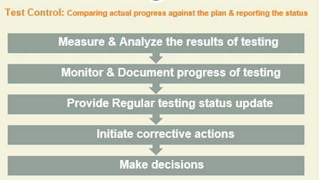
Test Control

Slide 46
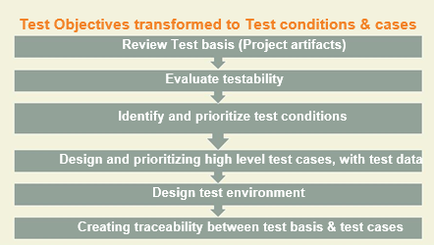
Test Analysis ““ What To Test ?“ and Test Design “How to Test”

Slide 47
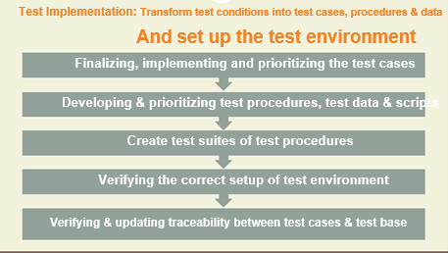
Test Implementation

Slide 48
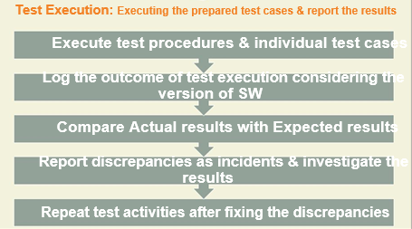
Test Execution

Slide 49
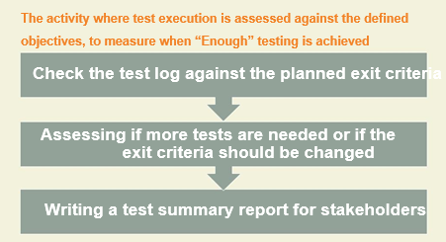
Evaluating Exit Criteria and Reporting - Test Completion

Slide 50
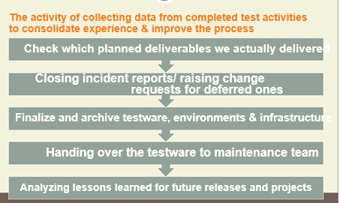
Test Closure Activities - Test Completion

Slide 51
Test Summary Report

Slide 52
Testware - Test Work Products
Testware is created as output work products from the test activities.
Test Activities | Work Products
Test planning | Test plan, test schedule, Risk , entry and exit criteria.
Test monitoring and control | Test progress reports
Test analysis | Test conditions (e.g., acceptance criteria)
Test design | Test cases, test charters, coverage items, test data requirements and test environment requirements.
Test implementation | Test procedures, automated test scripts, test suites, test data, test execution schedule, and test environment elements.
Test execution | Test logs, and defect reports
Test completion | Test completion report (Test Summary Report ), action items for improvement of subsequent projects or iterations, documented lessons learned, and change requests (e.g., as product backlog items).

Slide 53
Traceability between the Test Basis and Testware
Traceability of test cases to requirements can verify that the requirements are covered by test cases
Traceability of test results to risks can be used to evaluate the level of remaining risk in a test object.

Slide 54
Test Leader and Tester - Roles
Test Leader & Testers are the Main Two roles in Testing Team

Slide 55
Test Leader’s Tasks (Test management)
•Test policy-Test Strategy-Test Plan
•Test monitoring & Control (Test progress report-test summary report)
•Initiate the analysis, design, implementation, and execution of tests
•Configuration Management
•Metrics
•Tools selection
•Test Environment Implementation Decision
•Develop the skills and careers of testers

Slide 56
The Tester
A skilled professional who is involved in the testing of a component or system.

Slide 57
Tester’s Tasks
Review and contribute to test plans
•Assess requirements for testability
•Test conditions, test cases, test procedures, test data, & test execution schedule
•Test Environment setup
•Test Execution
•Test automation
•Non-Functional Testing
•Review tests developed by others

Slide 58
Specialized Testers
Performance
Security
Automation

Slide 59

Want to be a good Tester?

Slide 60
Whole Team Approach
Team member with the necessary knowledge and skills can perform any task, and everyone is responsible for quality.
The team members share the same workspace (physical or virtual), as co-location facilitates communication and interaction.
Testers work closely with other team members to ensure that the quality levels are achieved.

Slide 61
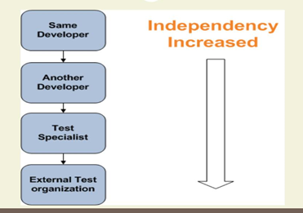
Level of Independence

Slide 62
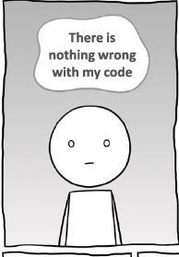
What is the Psychology of testing?
There should be clear communication and feedback on defects between tester and developer.
Tester when reporting bugs should focus on system behavior not on person who created the bug!
Since developers expect their code to be correct, difficult to accept that the code is incorrect.

Slide 64
Which of the following statements CORRECTLY describes one of the seven key principles of software testing?
A. By using automated testing it is possible to test everything
B. With sufficient effort and tool support, exhaustive testing is feasible for all software
C. It is impossible to test all input and precondition combinations in a system
D. The purpose of testing is to prove the absence of defects

Slide 65
Which of the following is a true statement about exhaustive testing?
A. It is a form of stress testing
B. It is not feasible except in the case of trivial software
C. It is commonly done with test automation
D. It is normally the responsibility of the developer during unit testing

Slide 66
Why is it important to avoid the pesticide paradox?
A. Dynamic testing is less reliable in finding bugs
B. Pesticides mixed with static testing can allow bugs to escape detection
C. Tests should not be context dependent
D. Running the same tests over and over will reduce the chance of finding new defects

Slide 67
Which of the below tasks is performed during the test analysis activity of the test process?
A. Identifying any required infrastructure and tools
B. Creating test suites from test scripts
C. Analyzing lessons learned for process improvement
D. Evaluating the test basis for testability

Slide 68
The following test work products,1-4, by mapping them to the right description, A-D.
1.Test suite
2. Test case
3. Test script
4. Test charter
A.A group of test scripts or test execution schedule
B.A set of instructions for the automated execution of test procedures
C. Contains expected results
D. An event that could be verified
a)1A, 2C, 3B, 4D.
b)1D, 2B, 3A, 4C.
c)1A, 2C, 3D, 4B.
d)1D, 2C, 3B, 4A.

Slide 69
When following the fundamental test process, when should the test control activity take place?
A. During the planning activities
B. During the implementation and execution activities
C. During the monitoring activities
D. During all the activities

Slide 70
If you need to provide a report showing test case execution coverage of the requirements, what do you need to track?
A. Traceability between the test cases and the requirements
B. Coverage of the risk items by test case
C. Traceability between the requirements and the risk items
D. Coverage of the requirements by the test cases that have been designed

Slide 71
Which of the following is the activity that compares the planned test progress to the actual test progress?
A. Test monitoring
B. Test planning
C. Test closure
D. Test control

Slide 72
Chapter 2: Testing Throughout the Software Lifecycle
Software Development Models
Test Levels
Test Types
Maintenance Testing

Slide 73
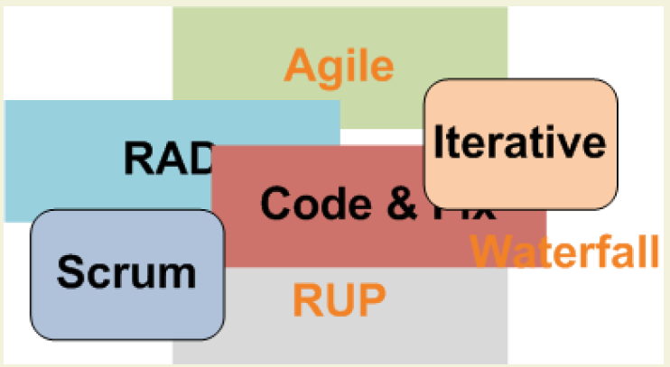
Software Development Models
A software development lifecycle model describes the types of activity performed at each stage in a software development project.

Slide 74
Characteristics of good Testing In any software lifecycle model
For every development activity, there is a corresponding test activity
Testers participate in the discussions to define requirements , design, and are involved in reviewing work products.

Slide 75
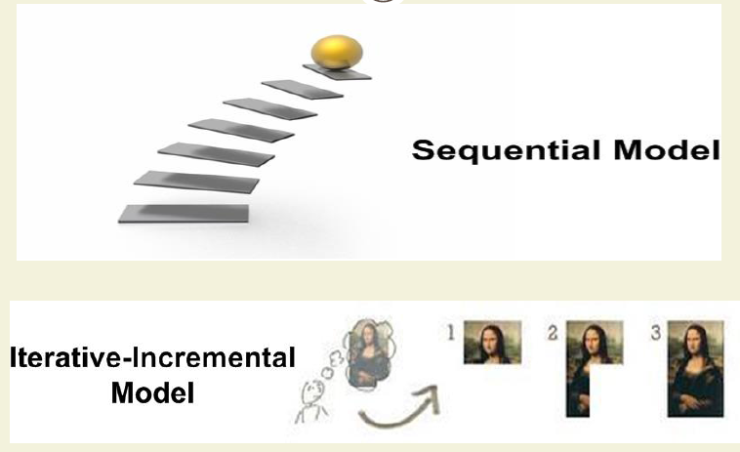
Software Development Models

Slide 76
Sequential Model
Describes the software development process as a linear, sequential flow of activities.
This means that any phase in the development process should be start when the previous phase is complete.
no overlap of phases

Slide 77
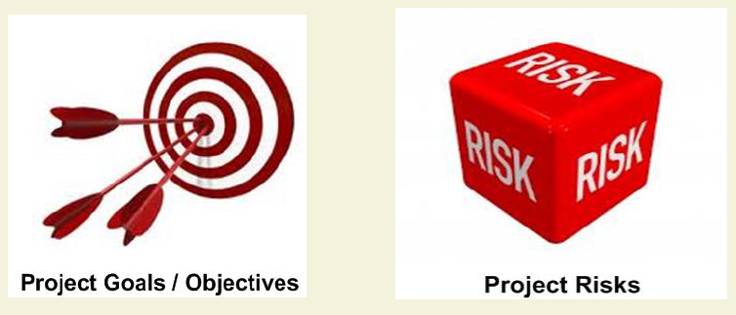
Which Model to select?

Slide 78
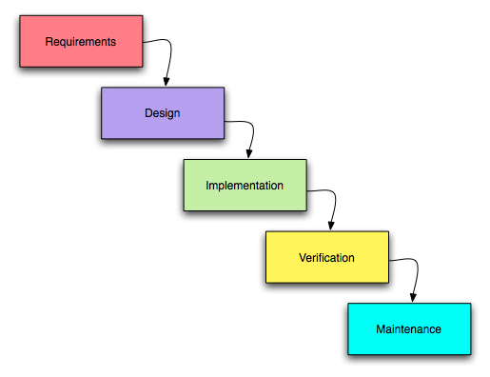
1) Waterfall Model
In the Waterfall model, the development activities are completed one after another.
In this model, test activities only occur after all other development activities have been completed

Slide 79
Advantage & disadvantage Waterfall Model
Advantage 1- This model is simple and easy to understand and use. 2- Phases do not overlap. 3- Waterfall model works well for smaller projects where requirements are clearly defined and very well understood.
Disadvantage 1- Once an application is in the testing stage, it is very difficult to go back and change something. 2- No working software is produced until late during the life cycle. 3- Not a good model for complex.

Slide 80
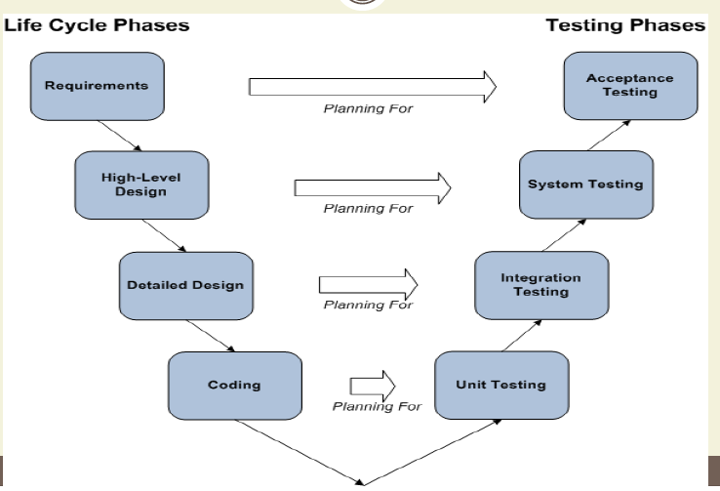
2) V-Model
V-model integrates the test process throughout the development process, implementing the principle of early testing.

Slide 81
Incremental & Iterative Development Model
Incremental development involves establishing requirements, designing, building, and testing a system in pieces, which means that the software’s features grow incrementally. but typically require months or years for delivery to stakeholders and users.
Iterative Development occurs when groups of features are specified, designed, built, and tested together in a series of cycles, often of a fixed duration, iteration delivers working software which is a growing subset of the overall set of features.

Slide 82
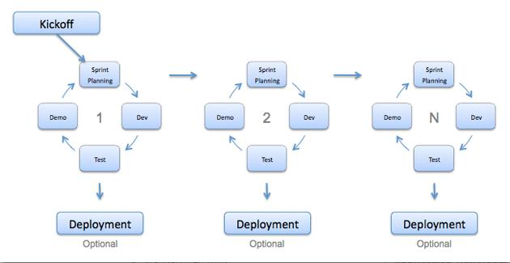
3) Agile model

Slide 83
Advantage & disadvantage Agile Model
Advantage 1- Customer satisfaction by continuous delivery of useful software. 2- Face-to-face conversation is the best form of communication by daily standup meeting. 3- Even late changes in requirements are welcomed 4- Working software is delivered frequently (2-4 weeks).
Disadvantage
1-Difficult to estimate the effort required at the beginning of the software development life cycle.
2- lack to focus on designing and documentation.

Slide 84
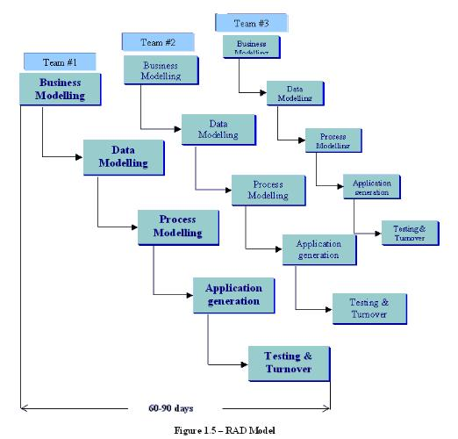
4)RAD model

Slide 85
5)Rational Unified Process
Each iteration tends to be relatively long (e.g., two to three months), and the feature increments are correspondingly large, such as two or three groups of related features.

Slide 87
6) Scrum
Each iteration tends to be relatively short (e.g., hours, days, or a few weeks), and the feature increments are correspondingly small, such as a few enhancements and/or two or three new features.

Slide 88
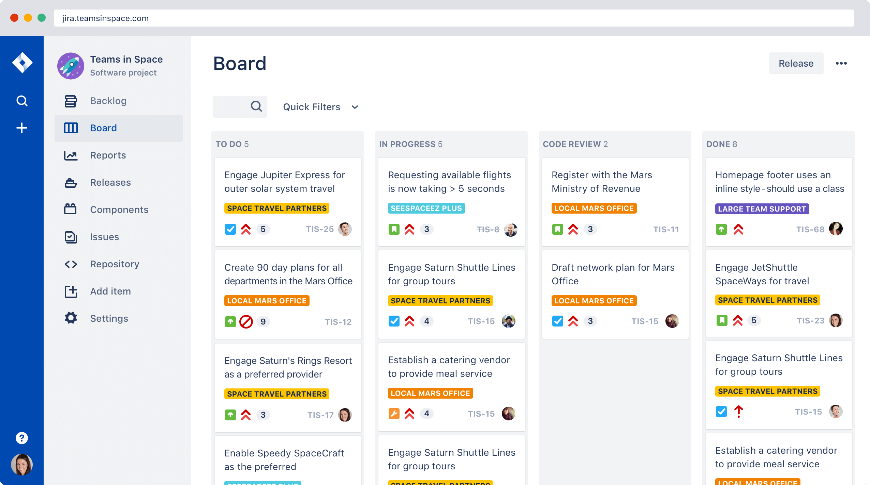
7) Kanban
Implemented with or without fixed-length iterations, which can deliver either a single enhancement or feature upon completion, or can group features together to release at once.

Slide 89
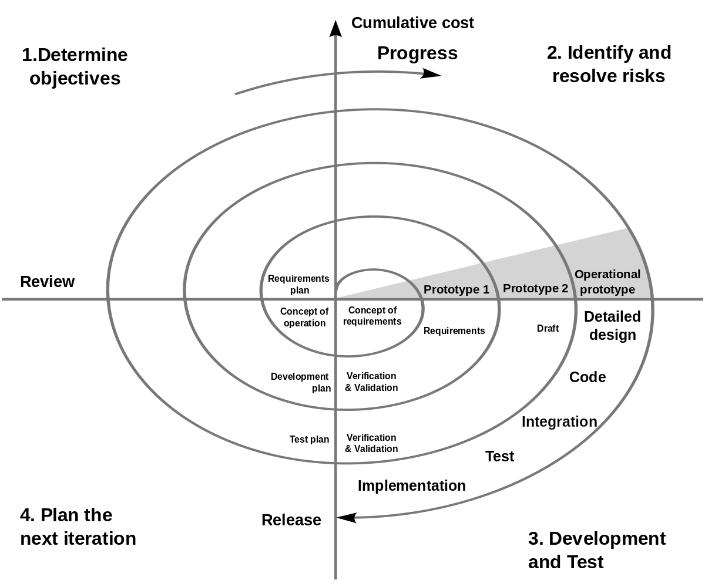
8- Spiral (or Prototyping)
Involves creating experimental increments, some of which may be heavily re-worked or even abandoned in subsequent development work.

Slide 91
Which one of the following is the BEST definition of an incremental development model?
A. Defining requirements, designing software and testing are done in a series with added pieces
B.A phase in the development process should begin when the previous phase is complete
C. Testing is viewed as a separate phase which takes place after development has been completed
D. Testing is added to development as an increment

Slide 92
Which of the following is a true statement regarding the V-model lifecycle?
A. Testing involvement starts when the code is complete
B. The test process is integrated with the development process
C. The software is built in increments and each increment has activities for requirements, design, build and test
D. All activities for development and test are completed sequentially

Slide 93
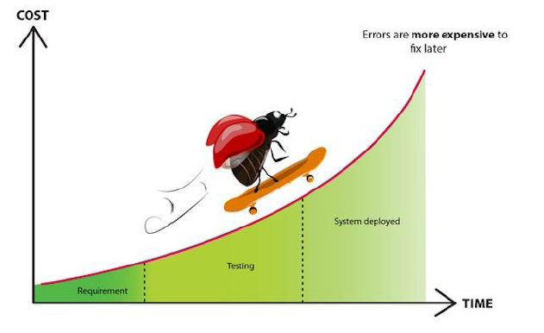
Cost of fixing faults

Slide 94
Test Levels

Slide 95
1) Unit / Component Testing
The testing of individual software components that are separate testable (Functions, classes, interfaces, modules)
Typical test objects for component testing include: Components, units or modules , Code ,data structures, Classes, Database modules.
Done by the developer

Slide 96
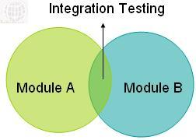
2) Integration Testing
The testing performed to expose defects in the interfaces between components, Interactions to different parts of a systems and in the Interfaces between systems.
Test objects for integration testing include: Subsystems, Databases, Infrastructure, Interfaces , and APIs.

Slide 97
Integration Testing Type
Component Integration For example, if integrating module A with module B, tests should focus on the communication between the modules, not the functionality of the individual modules, as that should have been covered during component testing.
System Integration
If integrating system X with system Y, tests should focus on the communication between the systems, not the functionality of the individual systems, as that should have been covered during system testing.

Slide 98
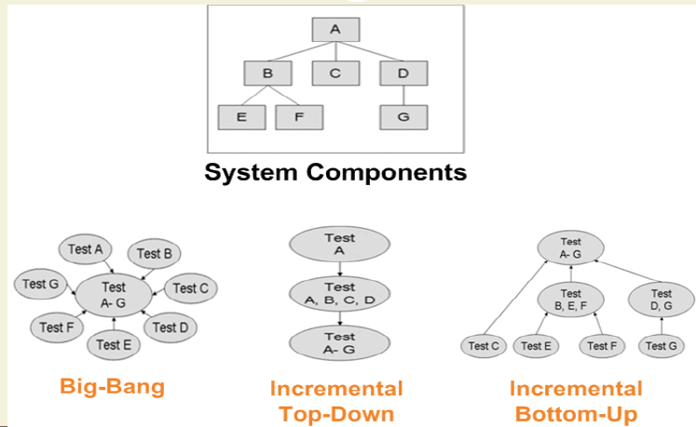
Integration Approaches

Slide 99
3) System Testing
Testing the behavior of a whole system as defined in the scope of development project, to verify it meets the requirements.
Typical test objects for system testing include: Applications , Hardware/software systems, Operating systems, System under test.
The test environment should correspond to the final target or production environment.
Independent testers typically carry out system testing.

Slide 100
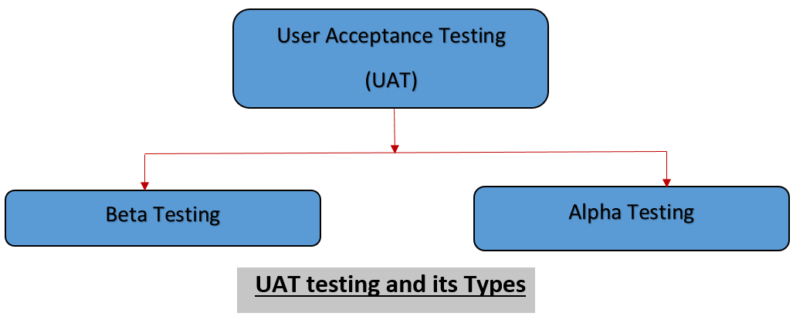
4)Acceptance Testing- Validation Testing
Formal testing with respect to user needs, requirements, and business processes conducted to determine if a system satisfies the acceptance criteria and to enable the user, customers or other authorized entity to determine whether or not to accept the system.

Slide 101
Alpha and Beta testing
Alpha testing is performed at the developing organization’s site by the customers.
Beta testing is performed by potential or existing customers, and/or operators at their own locations.

Slide 103
Which of the following comparisons of component testing and system testing is true?
A. Component testing verifies the functioning of software modules, program objects, and classes that are separately testable, whereas system testing verifies interfaces between components and interactions with different parts of the system
B. Test cases for component testing are usually derived from component specifications, design specifications, or data models, whereas test cases for system testing are usually derived from requirement specifications, functional specifications or use cases
C. Component testing focuses on functional characteristics, whereas system testing focuses on functional and non-functional characteristics
D. Component testing is the responsibility of the technical testers, whereas system testing typically is the responsibility of the users of the system

Slide 104
What type of testing is normally conducted to verify that a product meets a particular regulatory requirement?
A. Unit Testing
B. Integration Testing
C. System Testing
D. Acceptance Testing

Slide 105
Use cases are a test basis for which level of testing?
A. Unit
B. System
C. Load and performance
D. Usability

Slide 106
Testing Types
1-Functional Testing
2-Non-functional Testing
3-Structural Testing(White-box Testing)
4- Change-related Testing

Slide 107
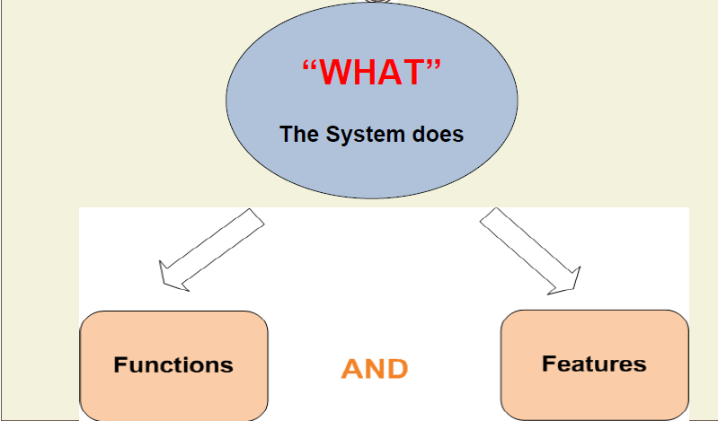
1) Functional Testing

Slide 108
2) Non-Functional Testing
Evaluates characteristics of systems and software such as usability,
performance efficiency or security.

Slide 109
3) Structural Testing (White-box Testing)
Tests on the system’s internal structure.(For loop , If statements)
Internal structure may include code, architecture, work flows, and/or data flows within the system

Slide 110
4- Change-related Testing
Confirmation testing(re-testing).
Regression testing

Slide 111
4.1 Confirmation testing (Re-Testing)
After a defect is fixed, the software tested with all test cases that failed due to the defect.

Slide 112
4.2 Regression Testing
It is possible that a change made in one part of the code may affect the other parts of the code.

Slide 113
Regression Testing Automation
Regression test suites are run many times so regression testing is a strong candidate for automation.

Slide 114
Test Types & Test Levels
•It is possible to perform any of the test types mentioned above at any test level.
•Functional testing at component level -> testing that the code performs its function
•Non-functional testing at component level -> testing how many cycles does the code use to work
•Functional testing at acceptance level -> testing that users can login successfully to the website
•Non-functional testing at acceptance level -> collect users feedback abut the usability of the application

Slide 115
Maintenance Testing
Any change after delivered software and go live.
Testing the Changes to the Operational System or the impact of the Changed Environment.
Depending on Size & Risk of Changes … Several Levels of Testing will be executed.
•Maintenance can involve planned releases and unplanned releases (hot fixes)

Slide 116
Type of Maintenance
Corrective Maintenance : modifications done in order to correct or fix defect.
Adaptive Maintenance : This includes modifications applied to keep the software product technology up-to date e.g. Update Library , SDK, change programming language from C to C+ [Without change on software functionality].
Perfective Maintenance: This includes modifications to add new features, new user requirements.
Preventive Maintenance: This includes modifications to prevent future problems of the software.

Slide 117
Example of Changes

Slide 118
Challenges

Slide 119
Testing as a Driver for Software Development

Slide 120
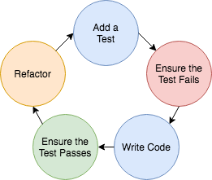
1.Test-Driven Development (TTD)
Test-driven development (TDD) is used to develop code guided by automated test cases
TDD is a “test first” approach to develop reusable automated tests
TDD helps to document the code for future maintenance efforts
Done by developer .

Slide 121
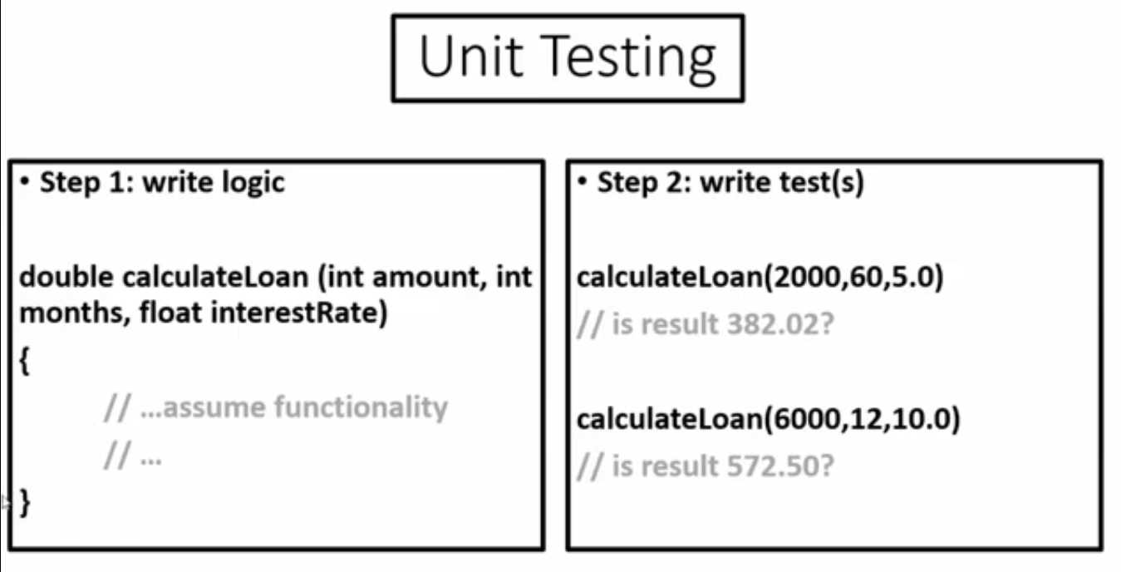

Slide 122
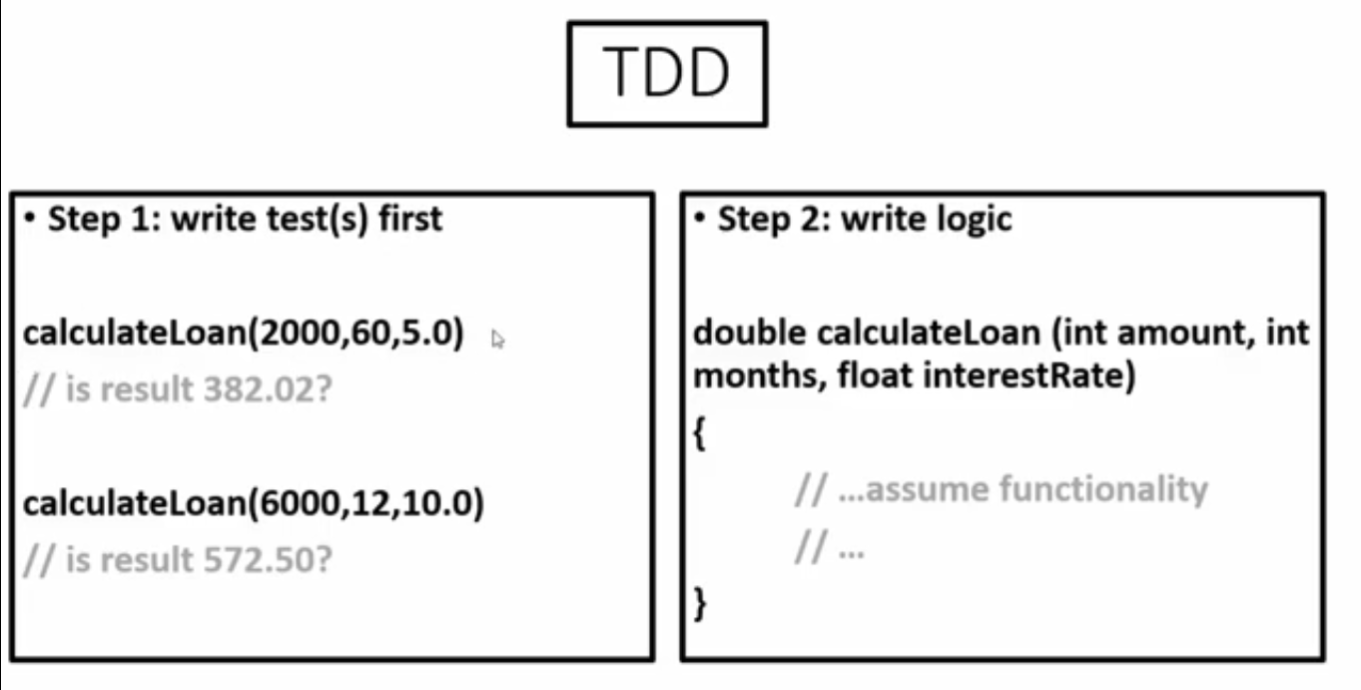

Slide 123
2.Acceptance Test-Driven Development (ATDD)
Acceptance test-driven development defines acceptance criteria and tests during the creation of user stories.
Acceptance test-driven development is a collaborative approach that allows every stakeholder to understand how the software component has to behave and what the developers, testers, and business representatives need to ensure this behavior.
ATTD reusable tests for regression testing.
ATTD is test –first approach , Test Cases created before implementing user story.
Test cases are created by agile team
Natural language so can all understand it.

Slide 124
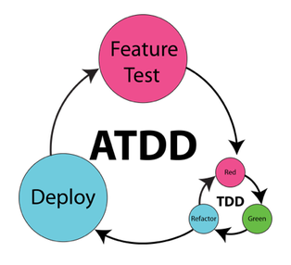
Acceptance Test-Driven Development (ATDD)

Slide 125
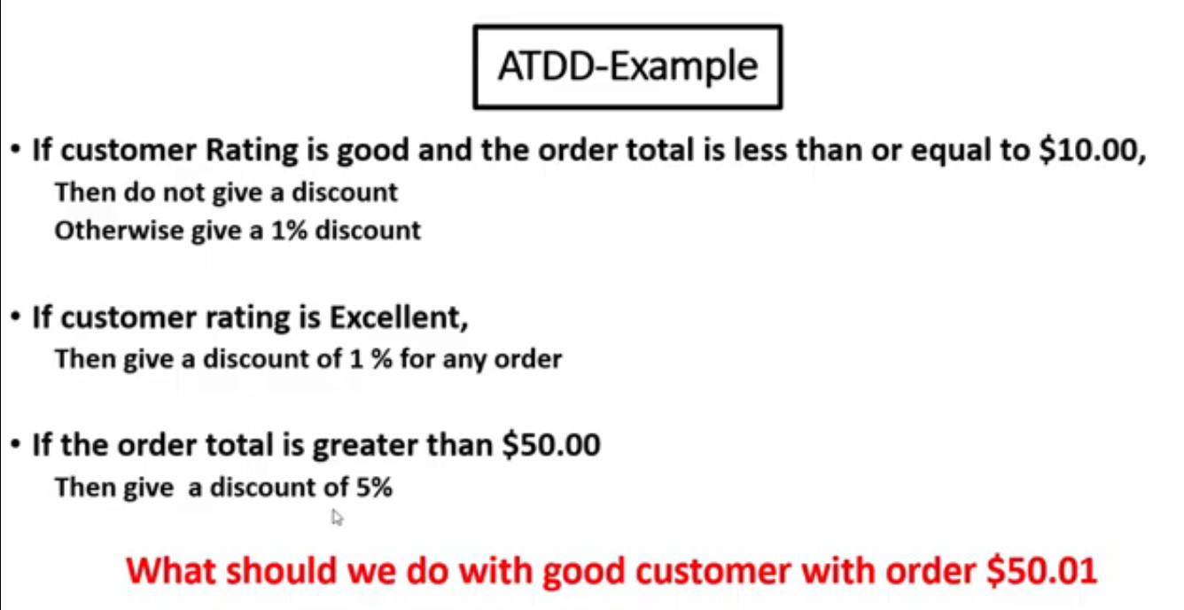

Slide 126
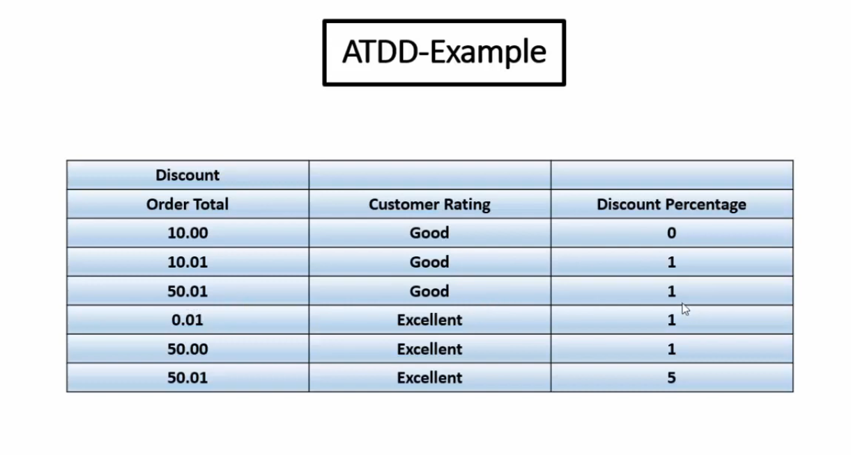

Slide 127
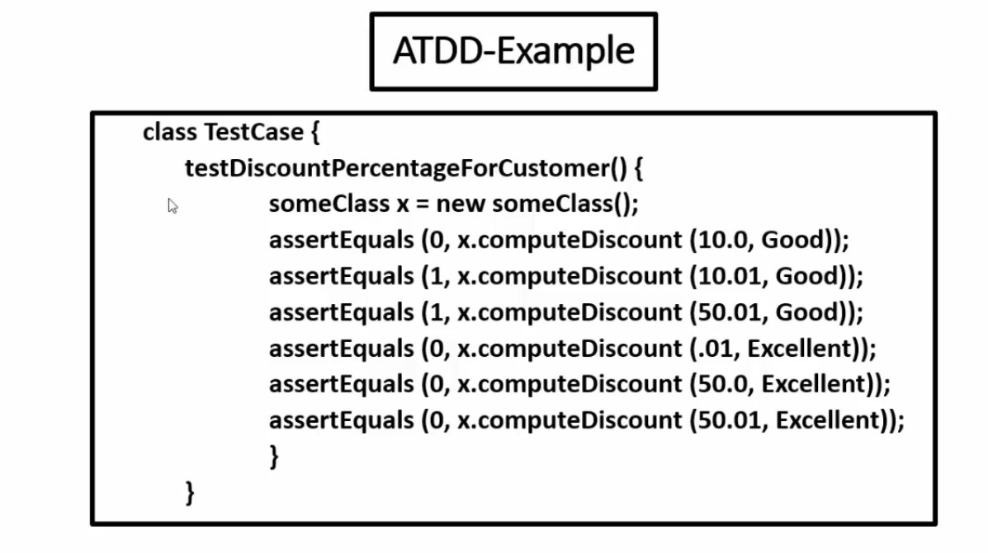

Slide 128
3.Behavior-Driven Development (BDD)
Behavior-driven development allows developer to focus on testing the code based on the expected behavior of the software.
From these requirements, the behavior-driven development framework generates code that can be used by developers to create test cases.
Given some context(Starting State),
When an event (What the user dose) occurs,
Then ensure some outcomes(Expected Result).

Slide 129
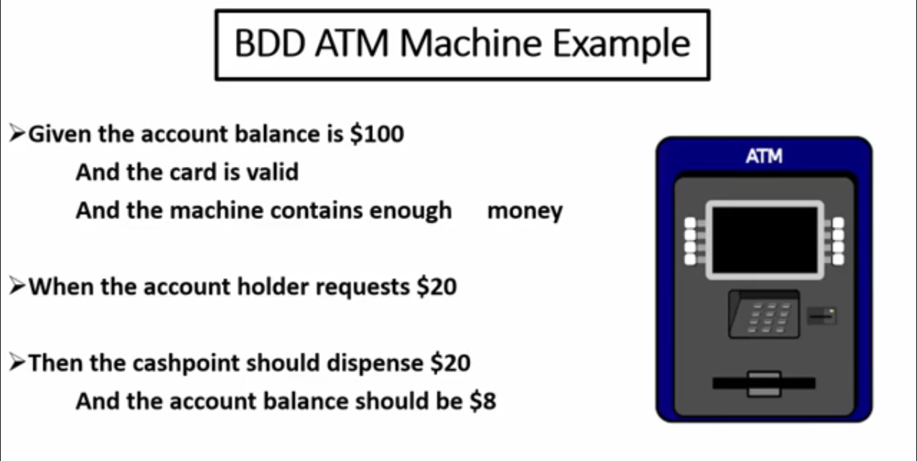

Slide 130
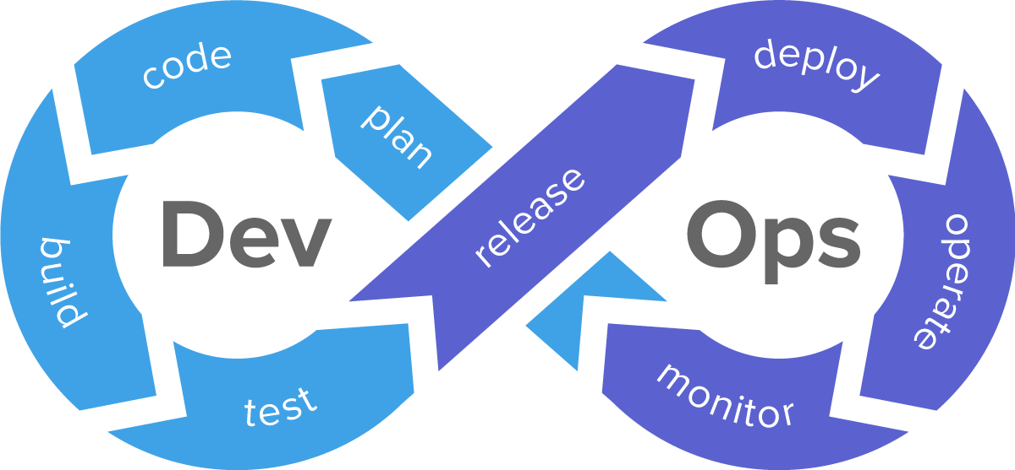
DevOps >> to build CI
Development and operations teams use to build, test, deploy, and monitor applications with speed, quality, and control.

Slide 131
benefits of DevOps
Fast feedback on the code quality.
• CI promotes a shift-left approach in testing by encouraging developers to submit high quality code accompanied by component tests and static analysis.
• Promotes automated processes like CI/CD that facilitate establishing stable test environments .
• Increases the view on non-functional quality characteristics (e.g., performance, reliability)
• Automation through a delivery pipeline reduces the need for repetitive manual testing.
• The risk in regression is minimized due to the scale and range of automated regression tests

Slide 132
DevOps risks and challenges
• The DevOps delivery pipeline must be defined and established
• CI / CD tools must be introduced and maintained
• Test automation requires additional resources and may be difficult to establish and maintain

Slide 133
Shift-Left Approach
The principle of early testing is sometimes referred to as shift-left because it is an approach where testing is performed earlier in the SDLC. Shift-left normally suggests that testing should be done earlier
shift-left include:
Reviewing the specification from the perspective of testing.
Writing test cases before the code is written.
Using CI and even better CD as it comes with fast feedback.
Completing static analysis of source code.
Performing non-functional testing starting at the component test level, where possible.

Slide 134
Retrospectives and Process Improvement
Retrospectives (also known as “post-project meetings” and project retrospectives) are often held at the end of a project or an iteration.
What was successful, and should be retained?
What was not successful and could be improved?
How to improvements and retain the successes in the future? (Action items).

Slide 135
Retrospectives benefits for testing include
Increased test effectiveness / efficiency (e.g., by implementing suggestions for process improvement)
• Increased quality of testware and test basis.
• Team learning
•Better cooperation between development and testing.

Slide 137
Which one of the following is TRUE?
A. The purpose of regression testing is to check if the correction has been successfully implemented, while the purpose of confirmation testing is to confirm that the correction has no side effects
B. The purpose of regression testing is to detect unintended side effects, while the purpose of confirmation testing is to check if the system is still working in a new environment
C. The purpose of regression testing is to detect unintended side effects, while the purpose of confirmation testing is to check if the original defect has been fixed
D. The purpose of regression testing is to check if the new functionality is working, while the purpose of confirmation testing is to check if the originally defect has been fixed.

Slide 138
Which of the following is most correct regarding the test level at which functional tests may be executed?
A. Unit and integration
B. Integration and system
C. System and acceptance
D. All levels

Slide 139
Usability testing is an example of which type of testing?
A. Functional
B. Non-functional
C. Structural
D. Change-related

Slide 140
You have been receiving daily builds from the developers. Even though they are documenting the fixes they are including in each build, you are finding that the fixes either aren’t in the build or are not working. What type of testing is best suited for finding these issues?
A. Unit Testing
B. System Testing
C. Confirmation Testing
D. Regression Testing

Slide 141
During which level of testing should non-functional tests be executed?
A. Unit and integration only
B. System testing only
C. Integration, system and acceptance only
D. Unit, integration, system and acceptance only

Slide 142
If impact analysis indicates that the overall system could be significantly affected by system maintenance activities, why should regression testing be executed after the changes?
A. To ensure the system still functions as expected with no introduced issues
B. To ensure no unauthorized changes have been applied to the system
C. To assess the scope of maintenance performed on the system
D. To identify any maintainability issues with the code

